Slide 1


D Internationals
Neha Vipperla | Aishani Sood | Himani Chauhan | Steve Essi | Arunima

Slide 2






The project is aimed at capturing details of internationals students in the US and provide insights on general demographics which include school enrollment, Jobs opportunities and industry involvement.
Use python to extract data from disparate sources.Create a dimension model, integrate and load data using SSIS, analyze and provide useful insights.
More than 1 M international students studying at U.S. colleges and universities contributed $39 billion to the U.S. economy.
Supported more than 455,622 jobs.
A 1.2 % increase in job support and creation.
US education currently ranks as the nation’s 6th largest services export.
-NAFSA
USCIS
Open Doors
US Department of Labor
US Department of State - Bureau
US Department of Education
Notes:
The data continue to demonstrate that international students and scholars are a tremendous asset to our nation, contributing billions of dollars to our economy, thus generating hundreds of thousands of jobs. And this is in addition to the immeasurable academic, security and cultural value these students bring. International students and scholars create jobs, drive innovation and serve as America’s best ambassadors and allies.
Importance: According to NAFSA:
“More than 1 M international students studying at U.S. colleges and universities contributed $39 billion to the U.S. economy.
Supported more than 455,622 jobs.
A 1.2 % increase in job support and creation.
*According to the U.S. Department of Commerce, education currently ranks as the nation’s 6th largest services export.*”
This will be a resource guide for internationals and research work.

Slide 3

Objectives
To explore education and employment opportunities in the US
03
Observe the trends in Student Enrollment and Tuition Fees
02
Observe the trends in H1B visa approvals.
01
To identify international hubs
Notes:
objectives in detail
strategy our team followed
To explore education and employment opportunities for internationals

Slide 4
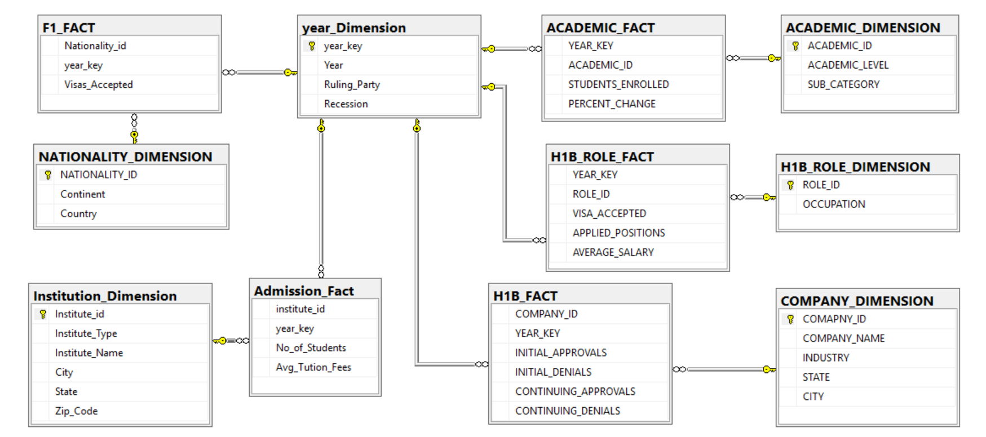
Dimensional model:
5 Facts, 6 Dimensions
Notes:
How did we create this model? identifying facts and dimensions?

Slide 5
Business Requirements
F-1 Visa and Student Enrollment statistics
Identify trends in F-1 Visa acceptance.
Top 3 places of origin for international students enrolled in US
Top 10 popular states for international students
Most expensive places in US for education
H-1B Visa and employment statistics
H-1B petitions by state
Trend in denial rate for H-1B visa
Denial rate for top companies
Top 5 occupation with highest visa acceptance
Average Salary of top 5 occupations with highest H-1B applications
Top 10 occupations with highest salary

Slide 6
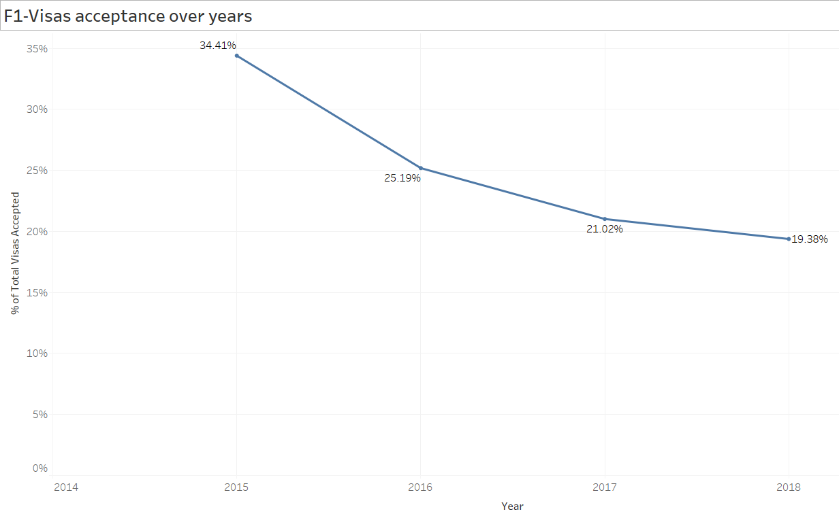

Slide 7
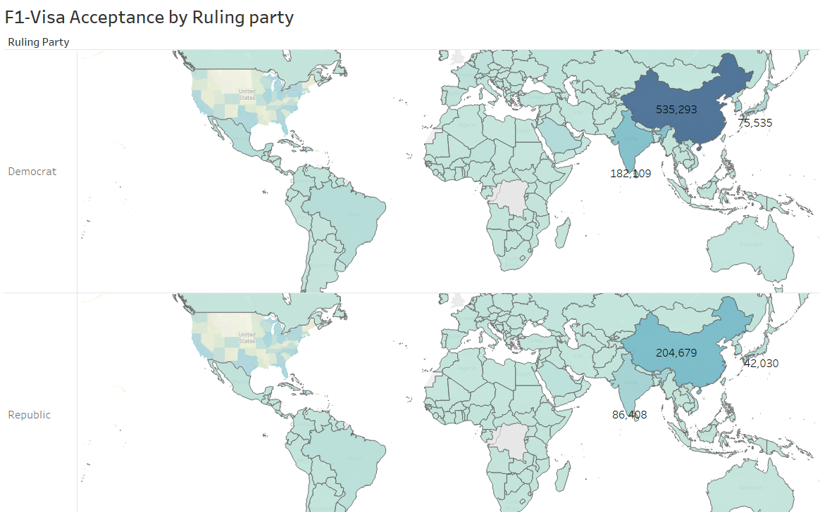

Slide 8
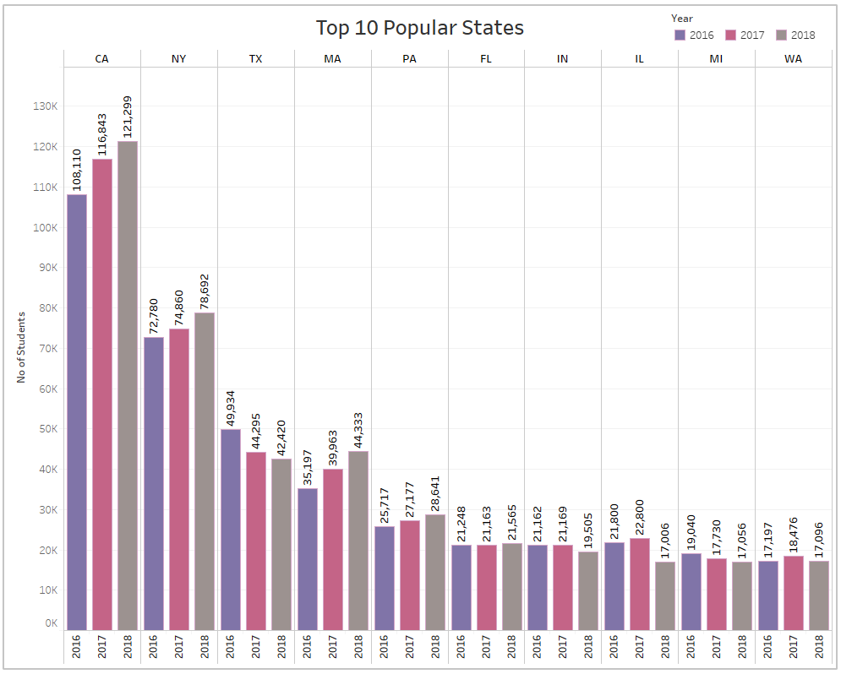
30%
41k +

Slide 9
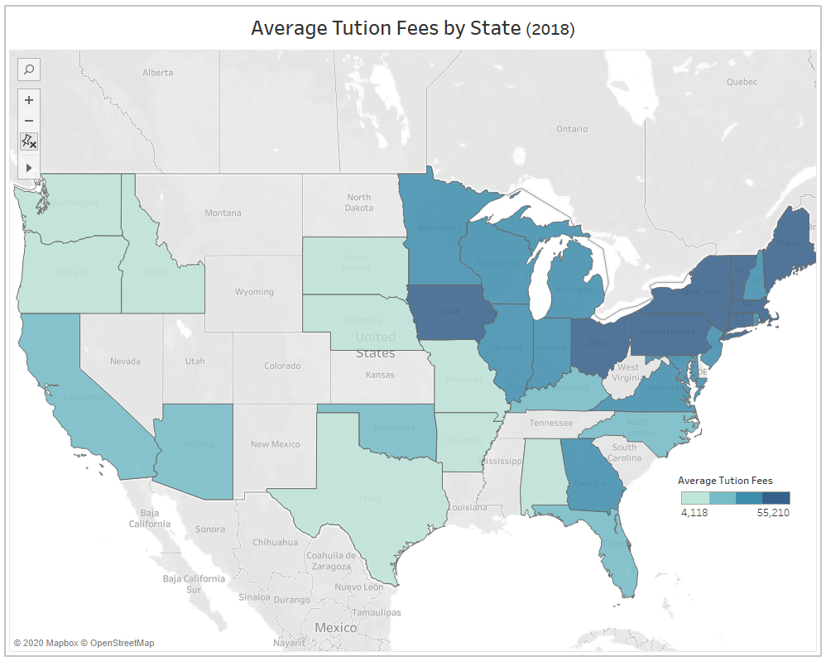
30%
41k +

Slide 10
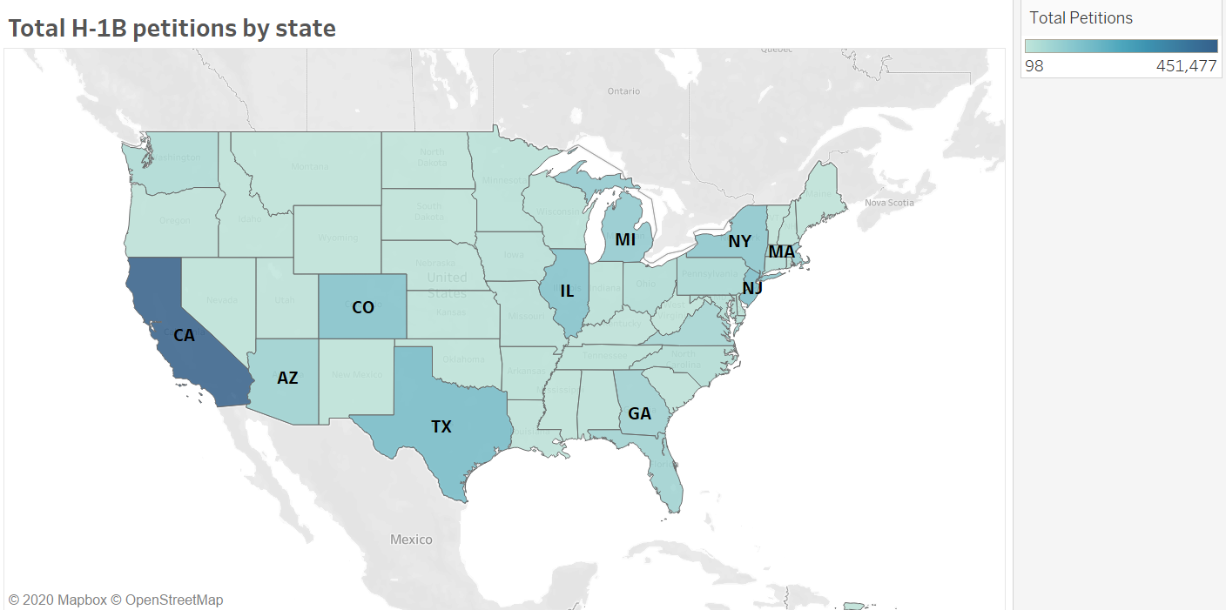

Slide 11
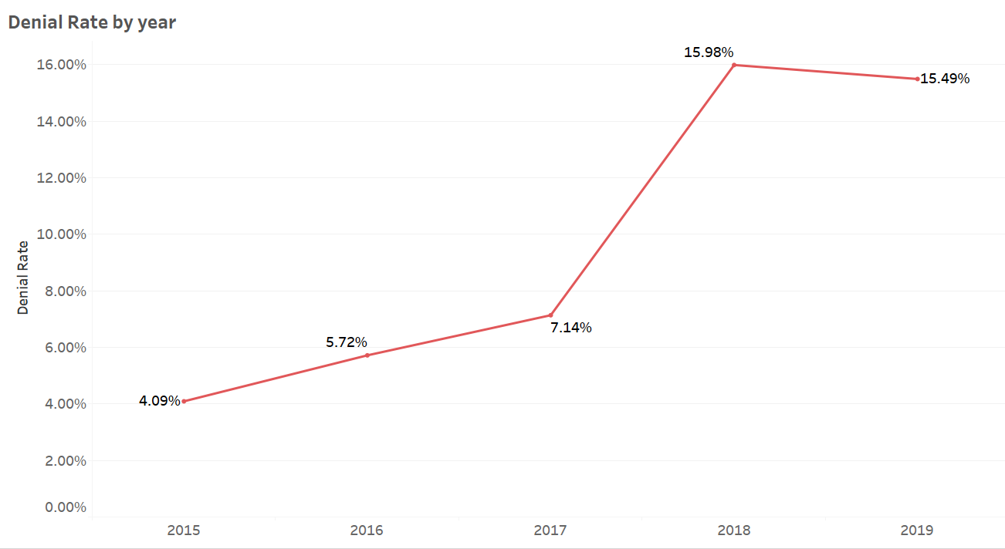

Slide 12
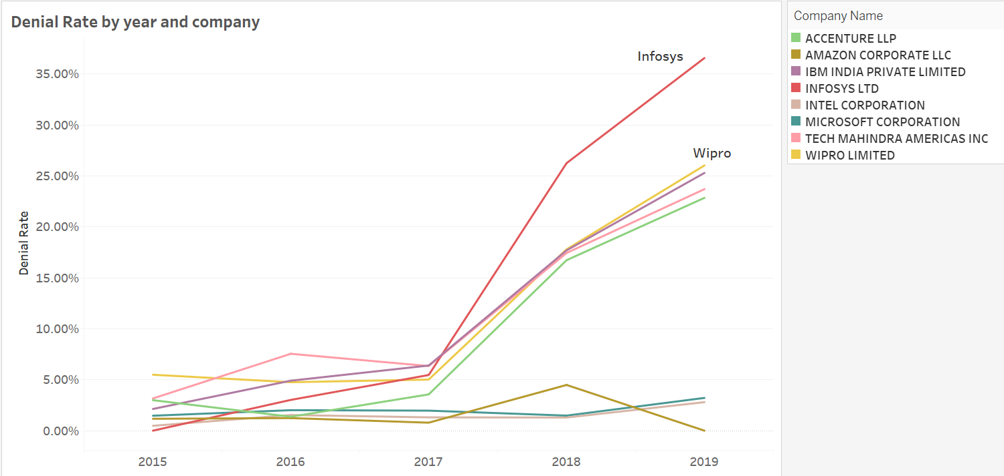

Slide 13
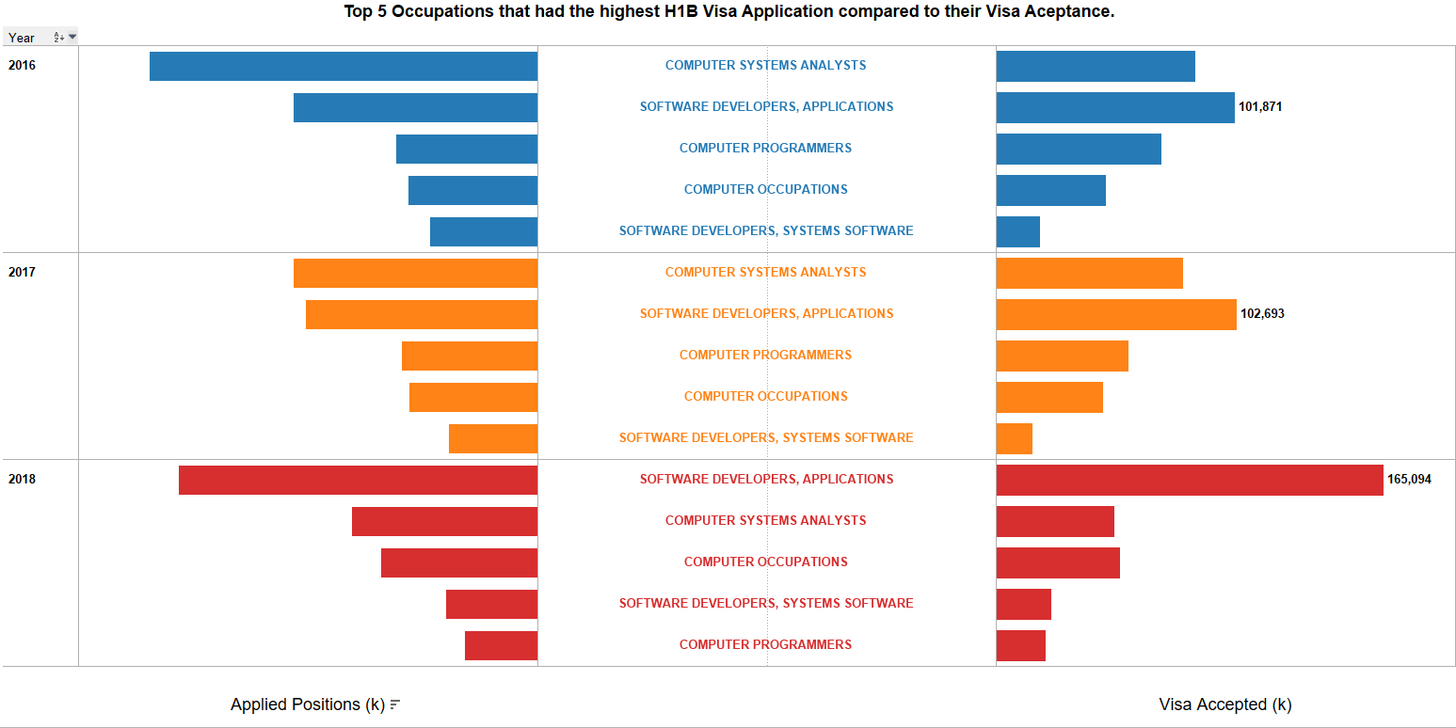
30%
41k +

Slide 14
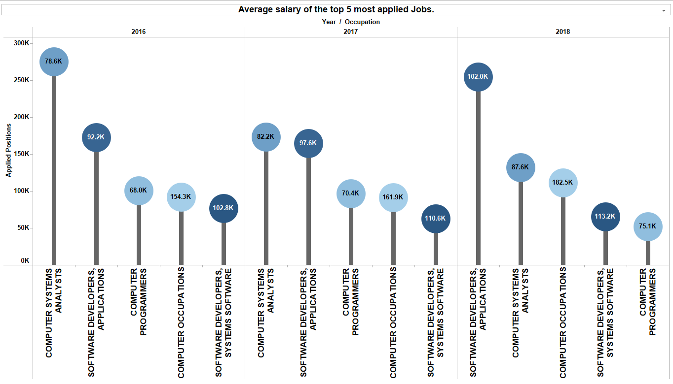
30%
41k +

Slide 15
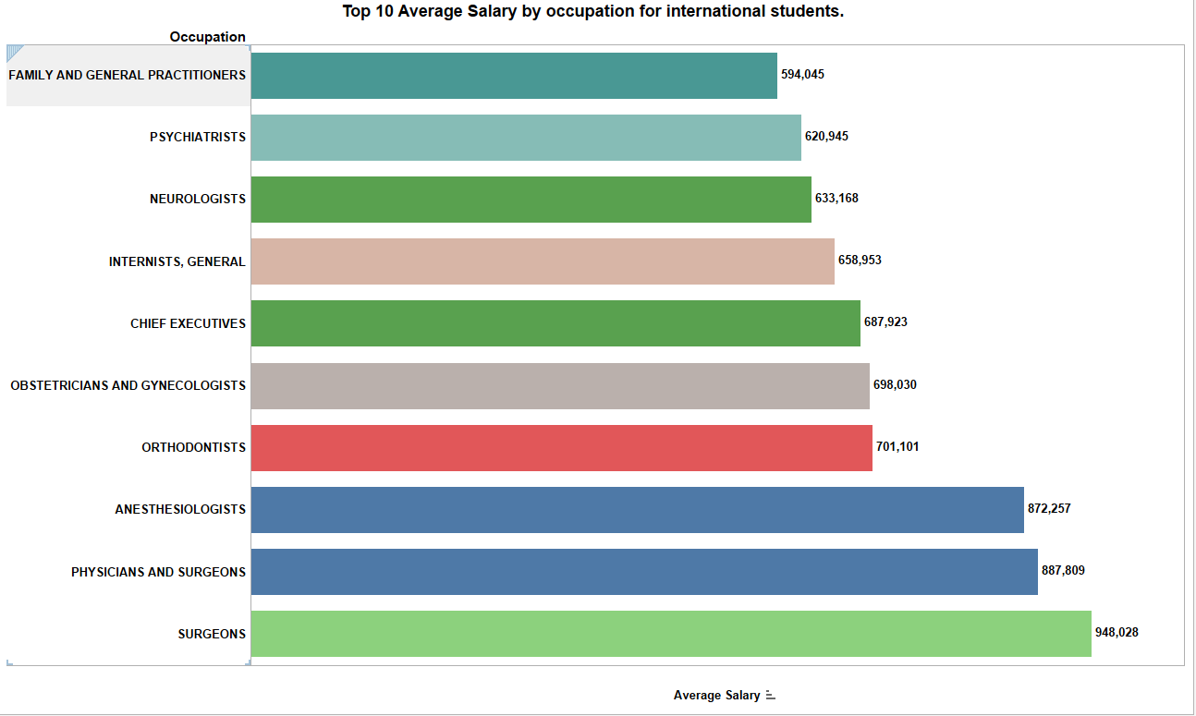
30%
41k +

Slide 16
Lessons learned
Web scraping the data from API
Identifying the dimensions and facts for the model
Use SSIS to perform Extract, Transform and Load
Connecting Tableau to SQL server for data analysis
Discovered that there are lot of public resources for internationals.

Slide 17

Challenges:
Creating the dimension model from disparate data
Collaborating online for the project
Data Cleaning (Missing values, Outliers, Misspelling errors)
Get the API key for access of data
Further analysis:
Economic impact of internationals
Explore different reasons for a decline in enrollment rate (funding, better opportunities in other countries, etc.)
Notes:
challenges faced and further analysis

Slide 18
THANK YOU
Notes:
concerted efforts to align national policies with institutional strategies to attract and retain international students. Immigration and visa policies must become more proactive and welcoming for international students. Likewise, higher education institutions must reinvest in strategies that grow international student body while balancing goals of diversity, quality, access, and success.

